Slide 1

Big Data
Usman Khan

Slide 2
Big Data
The term “big data” refers to data that is so large, fast or complex that it’s difficult or impossible to process using traditional methods. The act of accessing and storing large amounts of information for analytics has been around a long time. But the concept of big data gained momentum in the early 2000s when industry analyst Doug Laney articulated the now-mainstream definition of big data as the Five V’s:

Slide 3
The Five V of big data
Volume: Organizations collect data from a variety of sources, including business transactions, smart (IoT) devices, industrial equipment, videos, social media and more. In the past, storing it would have been a problem – but cheaper storage on platforms like data lakes and Hadoop have eased the burden.
Velocity: With the growth in the Internet of Things, data streams in to businesses at an unprecedented speed and must be handled in a timely manner. RFID tags, sensors and smart meters are driving the need to deal with these torrents of data in near-real time.
Variety: Data comes in all types of formats – from structured, numeric data in traditional databases to unstructured text documents, emails, videos, audios, stock ticker data and financial transactions.
Variability: In addition to the increasing velocities and varieties of data, data flows are unpredictable – changing often and varying greatly. It’s challenging, but businesses need to know when something is trending in social media, and how to manage daily, seasonal and event-triggered peak data loads.
Veracity: Veracity refers to the quality of data. Because data comes from so many different sources, it’s difficult to link, match, cleanse and transform data across systems. Businesses need to connect and correlate relationships, hierarchies and multiple data linkages. Otherwise, their data can quickly spiral out of control.

Slide 4
How Big Data works
Before businesses can put big data to work for them, they should consider how it flows among a multitude of locations, sources, systems, owners and users. There are five key steps to taking charge of this big “data fabric” that includes traditional, structured data along with unstructured and semi structured data:
Set a big data strategy.
Identify big data sources.
Access, manage and store the data.
Analyze the data.
Make data-driven decisions.

Slide 5
Why Is Big Data Important?
Benefits:
The importance of big data doesn’t revolve around how much data you have, but what you do with it. You can take data from any source and analyze it to find answers that enable
1) cost reductions,
2) time reductions,
3) new product development and optimized offerings,
4) smart decision making.
When you combine big data with high-powered analytics, you can accomplish business-related tasks such as:
Determining root causes of failures, issues and defects in near-real time.
Generating coupons at the point of sale based on the customer’s buying habits.
Recalculating entire risk portfolios in minutes.
Detecting fraudulent behavior before it affects your organization.

Slide 6
Challenges
Storing such a huge amount of data efficiently.
How do we process and extract valuable information from this huge amount of data within a given timeframe?
DATA Security / Privacy.

Slide 7
Language & Technologies
Scala
Python
Hadoop
Spark
Apache
Power BI
Tablue

Slide 8
Data mining
The components of data mining mainly consist of 5 levels, those are: –
Extract, transform and load data into the warehouse
Store and manage Data
Provide data access (Communication)
Analyze (Process)
User Interface (Present data to user)

Slide 9
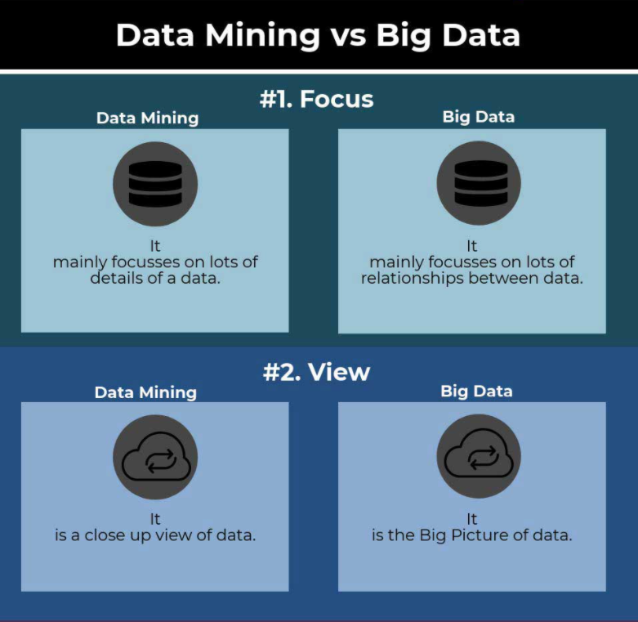

Slide 10
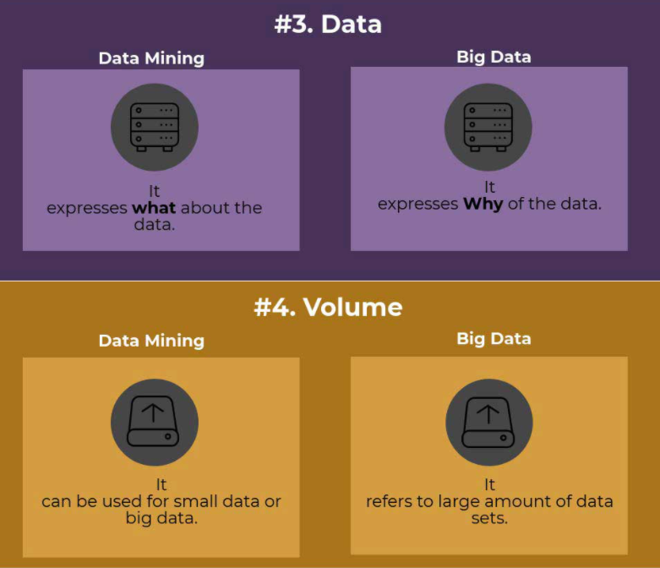

Slide 11
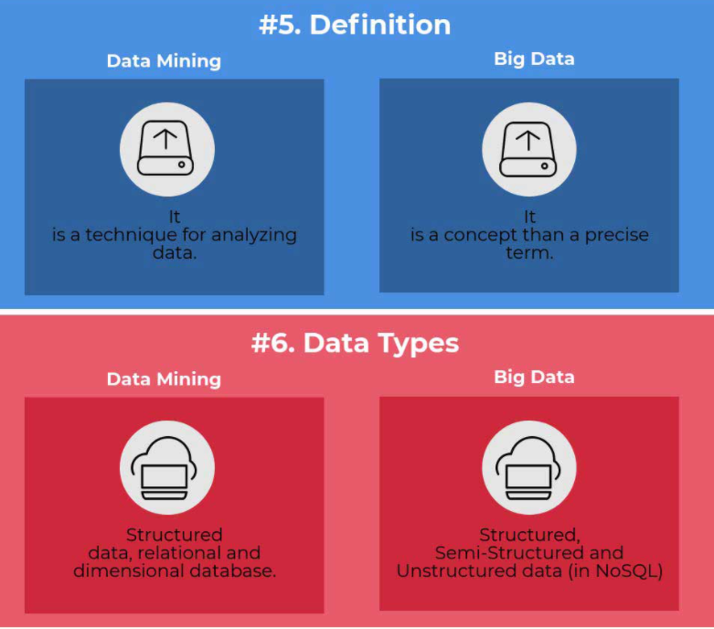

Slide 12
Applications
Artificial Intelligence
Deep Learning
Data Science
Human less Labour
Retail Automation
Medical Prescription / Analytics

Slide 13
How AI uses big data
Creating new methods for analyzing data: One of the fundamental business problems of big data could sometimes be summarized with a simple question: Now what? As in: We’ve got all this stuff (that’s the technical term for it) and plenty more of it coming – so what do we do with it? In the once-deafening buzz around big data, it wasn’t always easy to hear the answers to that question.
Data analytics is becoming less labor-intensive: As a result, managing and analyzing data depends less on time-consuming manual effort than in the past. People still play a vital role in data management and analytics, but processes that might have taken days or weeks (or longer) are picking up speed thanks to AI.
Analytics become more predictive and prescriptive: In the past, data analytics was more postmortem than anything else: “Here’s what happened.” Future predictions were still essentially historical analyses. AI and ML are helping open a new front: “Here’s what’s going to happen.” (Or at least “here’s what likely going to happen.”) Moreover, an ML algorithm can also be taught to make a decision or take an action based on that forward-looking insight.

Slide 14
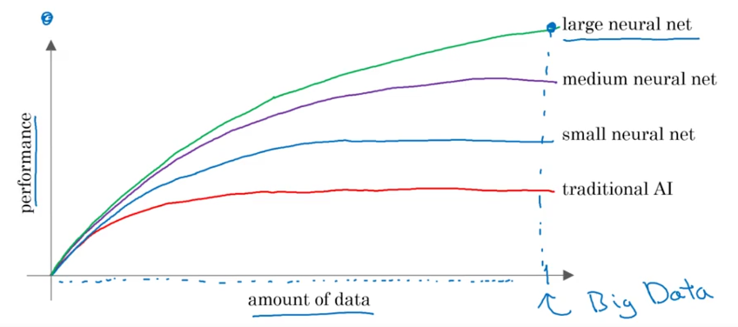

Slide 15
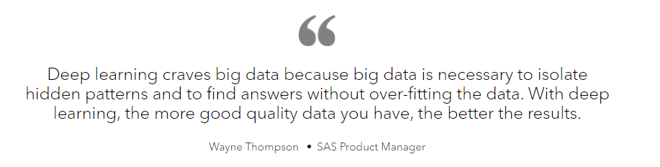

Slide 16
TOP BIG DATA COMPANIES
TERA DATA
IBM
SAP
Salesforce.
Alteryx.
Cloudera.
Segment.
Crunchbase.
Google.
Oracle.

Slide 17
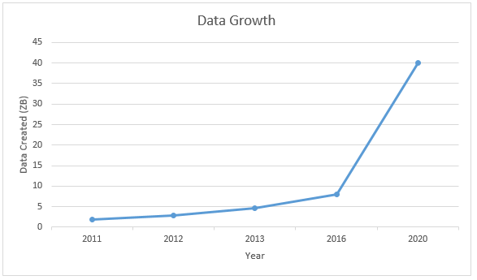
Future of big data

Slide 18
Thank You

